Slide 1
OpenGL Demo – Desktop App
Brandon Kiser

Slide 2
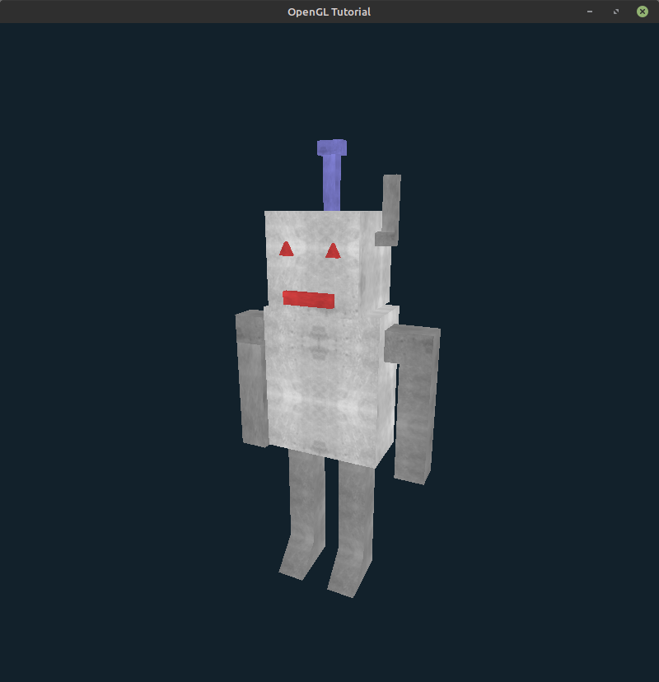
Description
PA3 robot rendered with OpenGL
Emphasis on abstracting API calls to objects to clean up main() function
HCI component: Movable first-person camera with WASD/mouse controls
Utilizes matrix transformations and texture mapping

Slide 3
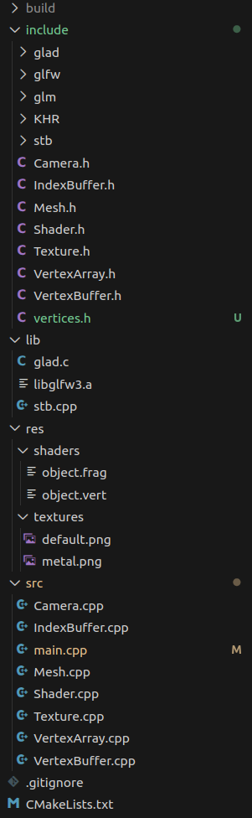
Design
C++ application, built using Cmake
Object-oriented approach, utilize classes for code organization
Separate classes for meshes, camera functions, VAO configuration, etc.

Slide 4
Implementation Tools
Language: C++
Libraries:
GLFW – generate window, handle input
GLAD – include macros for OpenGL functions
GLM – math library for matrix/vector operations
stb_image – load .png images as binary for OpenGL textures

